Slide 1
Final Project Review
F15.E3
Christian Tschoepe, Sean Wang, Dinh Huynh

Slide 2
Part I
ARL APEX Application

Slide 3
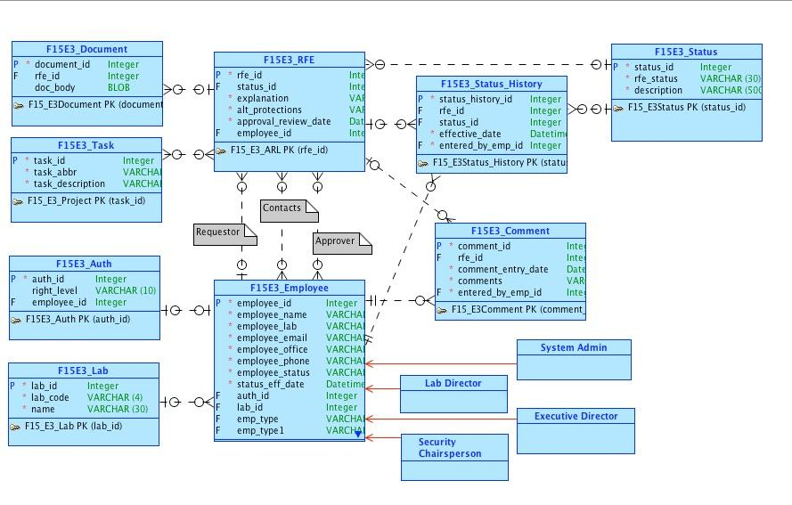
Conceptual Model

Slide 4
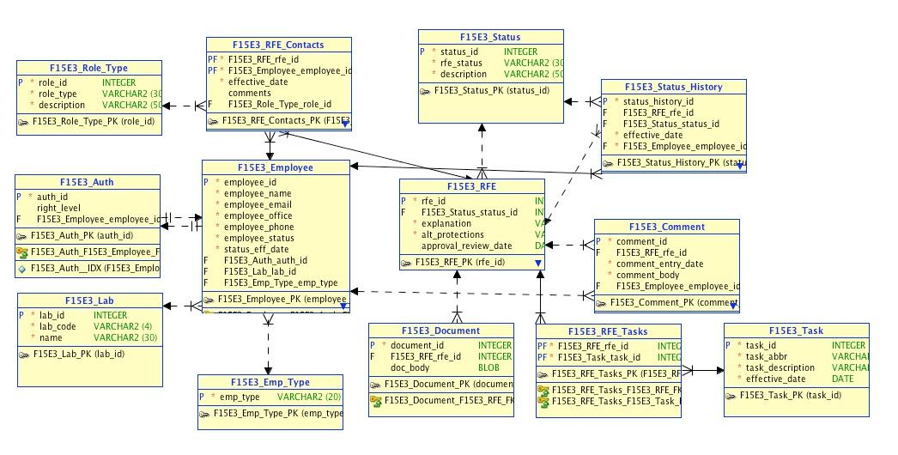
Relational Model

Slide 5
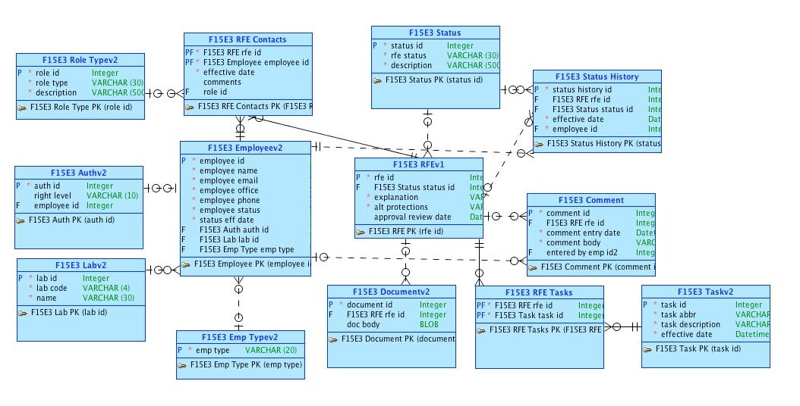
Logical Model

Slide 6
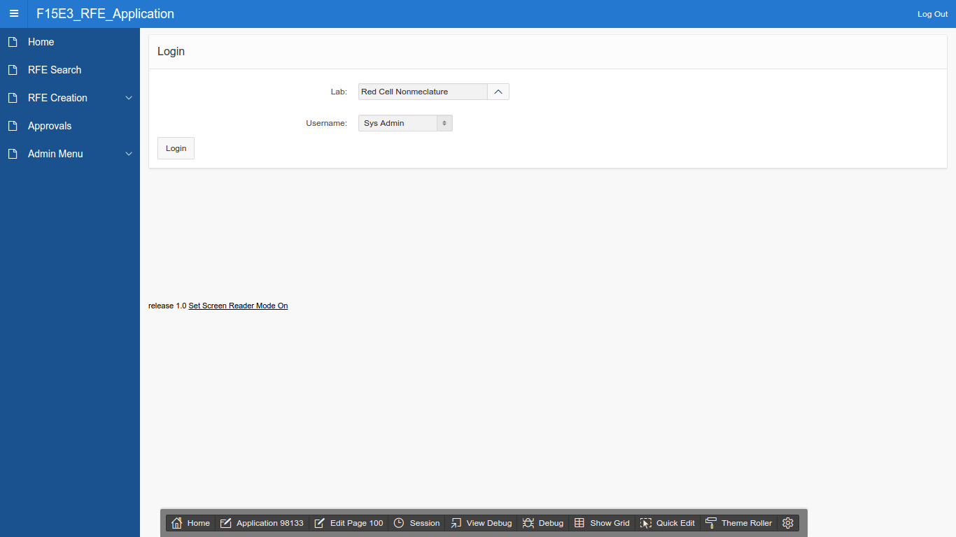
Representative Screenshots

Slide 7
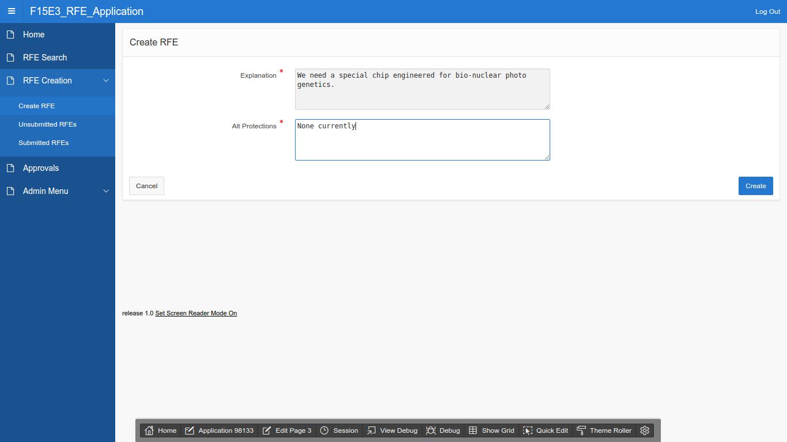

Slide 8
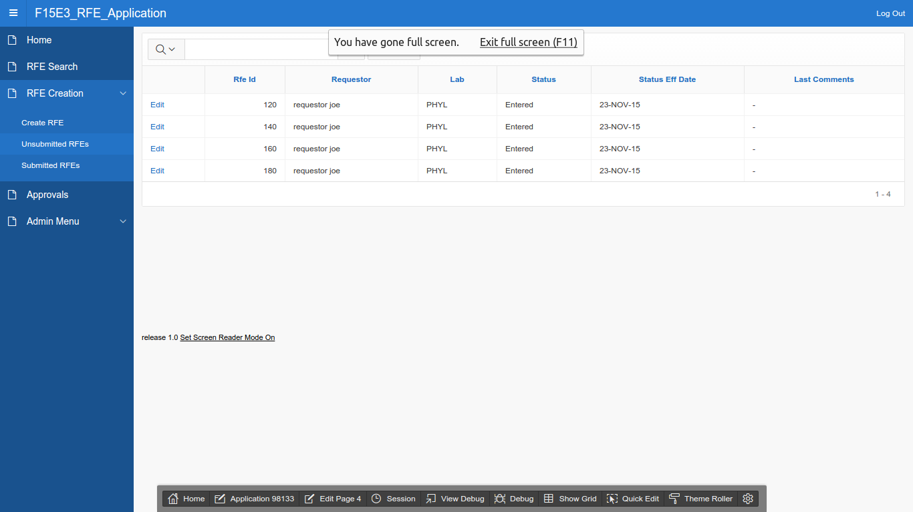

Slide 9
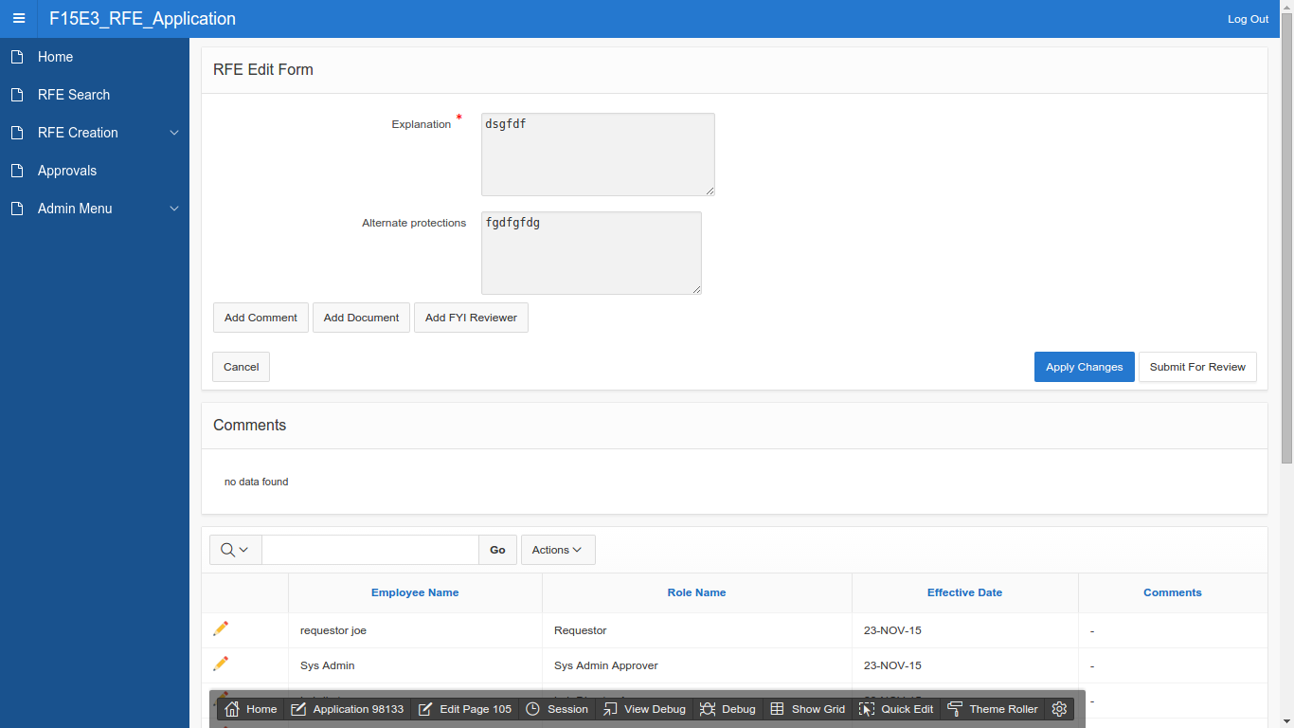

Slide 10
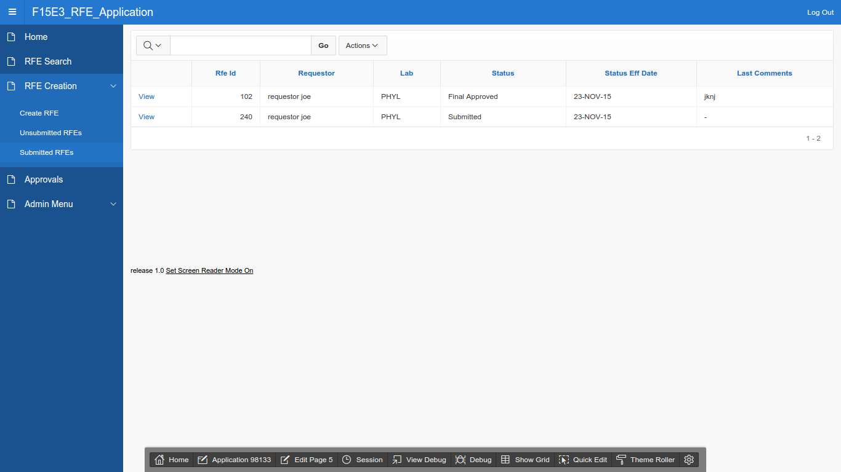

Slide 11
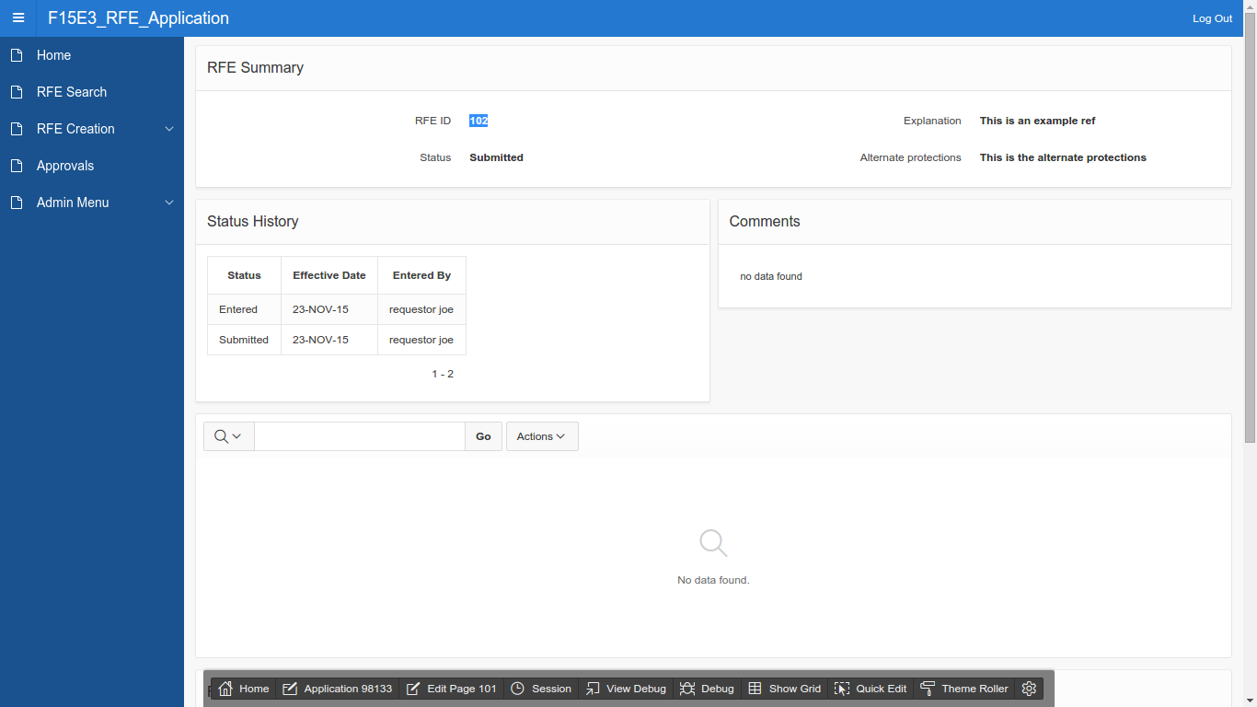

Slide 12
Part II
APEX Mobile Application

Slide 13
Movies Mobile App
Shows the correlation of gross income generated from different movie genres on different movie distributors.
Collected movie data from 7 of the biggest movie’s distributors in the US and plotted them by movie genre against total gross income.
Users can choose a distributor from a drop down menu to generate charts for various distributors.

Slide 14
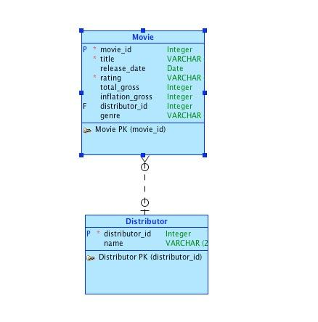
Conceptual Model

Slide 15
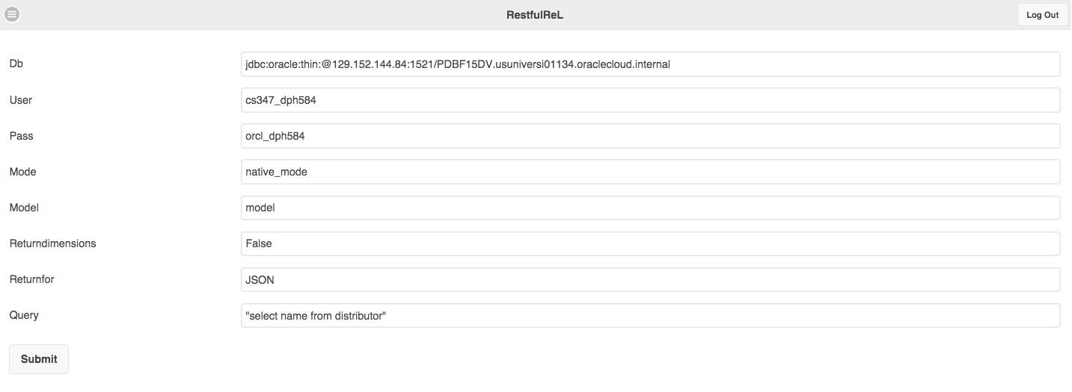

Slide 16
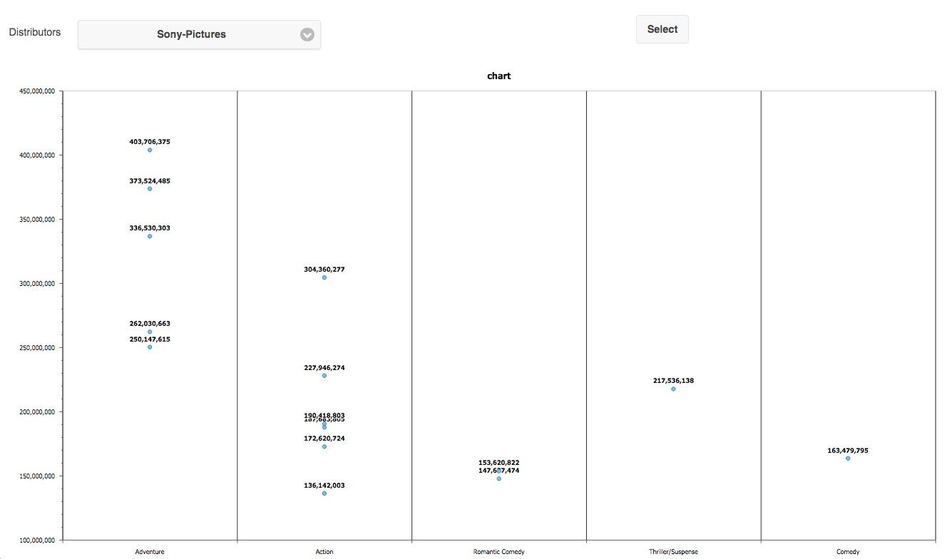
Representative Screenshots

Slide 17
Project Links
Github repo: https://github.com/chriswins2much/F15E3-ARL-Project
ARL APEX Application: https://apex.oracle.com/pls/apex/f?p=98133:1:4346846584294::NO:::
APEX Movies Mobile App: https://apex.oracle.com/pls/apex/f?p=83629:3:9310392651551::NO:::

Slide 18
Data from Part II
Links:
http://www.the-numbers.com/market/distributor/Walt-Disney
http://www.the-numbers.com/market/distributor/Universal
http://www.the-numbers.com/market/distributor/Warner-Bros
http://www.the-numbers.com/market/distributor/20th-Century-Fox
http://www.the-numbers.com/market/distributor/Paramount-Pictures
http://www.the-numbers.com/market/distributor/Lionsgate
http://www.the-numbers.com/market/distributor/Sony-Pictures
jQuery:
var script = document.createElement('script'); script.src = "http://code.jquery.com/jquery-2.1.4.min.js"; document.head.appendChild(script); $("#page_filling_chart table:first-of-type tbody tr").each(function() { console.log("INSERT INTO Movies (movie_id, title, released_date, genre, rating, total_gross, inflation_gross, distributor_id) VALUES (DEFAULT, " + $(this).find("td:not(:first-of-type)").get().map(function(e) { try{ return JSON.parse($(e).text().replace(/,/g, "").replace(/\$/g, "")); } catch(exc) { return ("\"" + $(e).text() + "\""); } }).join(", ") + ", <<Distributor_id>>);"); });

